Slide 1
Roll Your Own Mobile Framework
Notes:
Name
Company
What I do – Mobile web dev

Slide 2
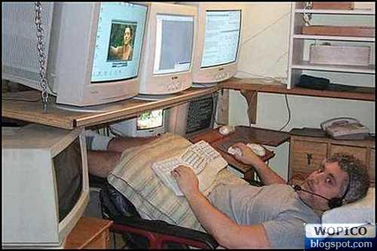
Notes:
Daryl
Bright dude.
New to WEB dev
Updating the CORE PRODUCT & adding a new mobile experience
Excited about Html CSS and JavaScript – seems really cool

Slide 3
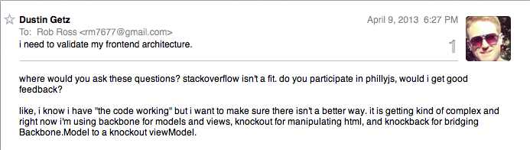
Notes:
He’s invested considerable time
“sorta working’
Not fully understating it
Not really sure how to maintain it
Problem: Talking about the structure of their core products in terms of libraries and frameworks. Core product – as in going to sell and keep the company in business core product.

Slide 4
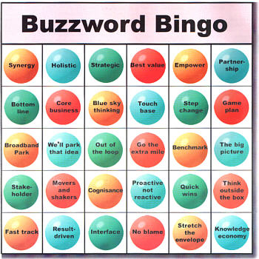
Notes:
But I’m using the ‘right’ ie popular tools.

Slide 5

Notes:
A lot of dependencies.
A ton of code.
Not confident in it.

Slide 6
<script type="text/javascript" src=“[noun].js"></script>
Notes:
What’s the benefits and cost of doing this?

Slide 7
Cross Platform
Notes:
Runs on all device (just like the web)
Html, CSS, JavaScript are everywhere already

Slide 8

Notes:
They don’t being anything new to the table.

Slide 9
Rapid Development
Notes:
I want to just focus on getting things built.
OK for a prototype or some one off that’s not a core part of your project/business
What’s the cost of rapid development

Slide 10
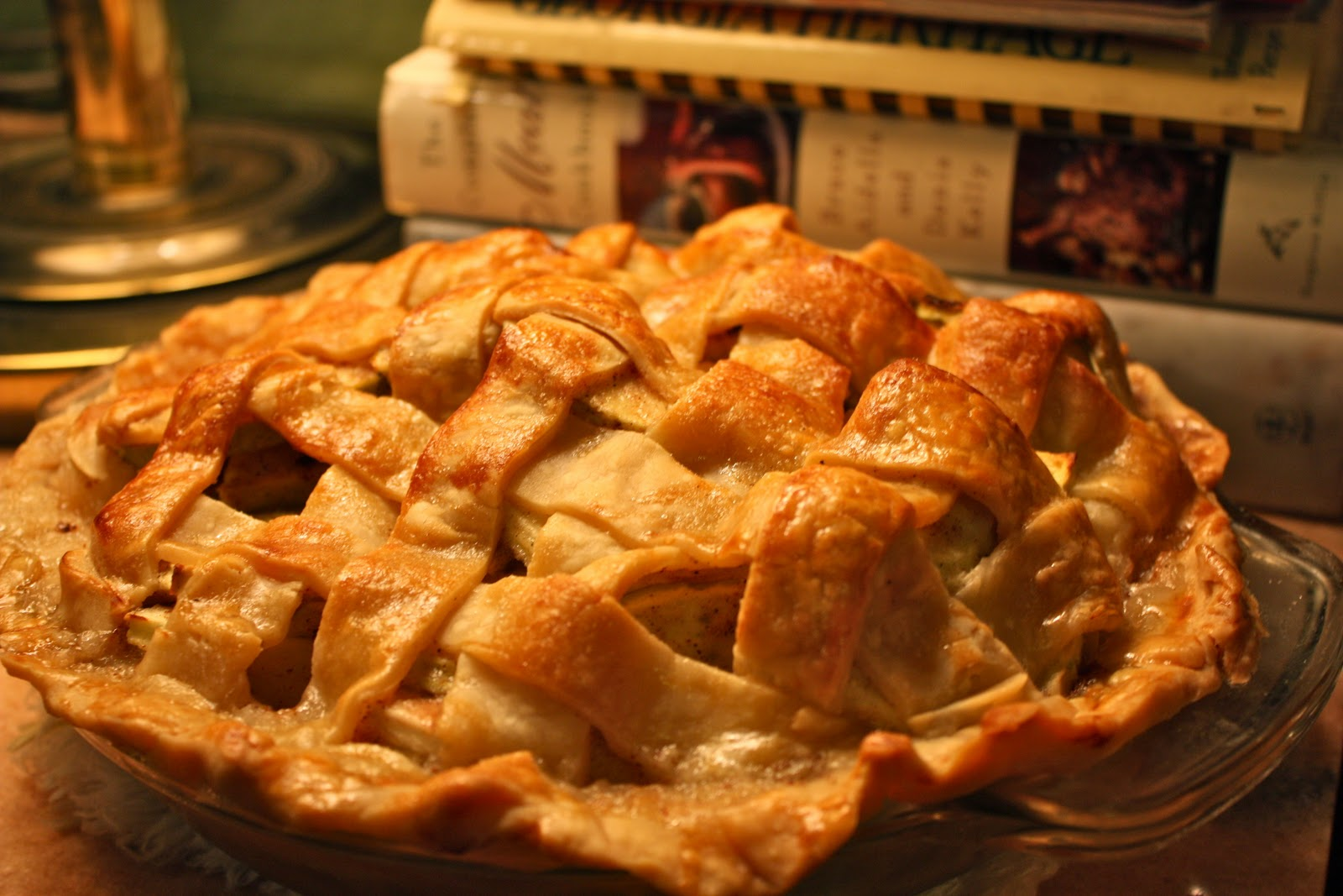
Notes:
Why is “home made” better?
Not advertised as “you won’t believe how fast we made this”
Infer a sense of care and understanding about how the recipe was developed and how the pie was baked.
If you’re in the business of selling pies – which is better?

Slide 11
frameworks are…
Notes:
Tool for building a application
Structure
Common utilities
Foundation on which we build apps
Code which calls your code

Slide 12
frameworks are… Abstractions
Notes:
a way to model an application
must enforce organization, rules, and constraints

Slide 13
frameworks are… General Purpose Abstractions
Notes:
Must be useful for many applications
Include all the bits folks might want (size)
Include bits some folks don’t need

Slide 14
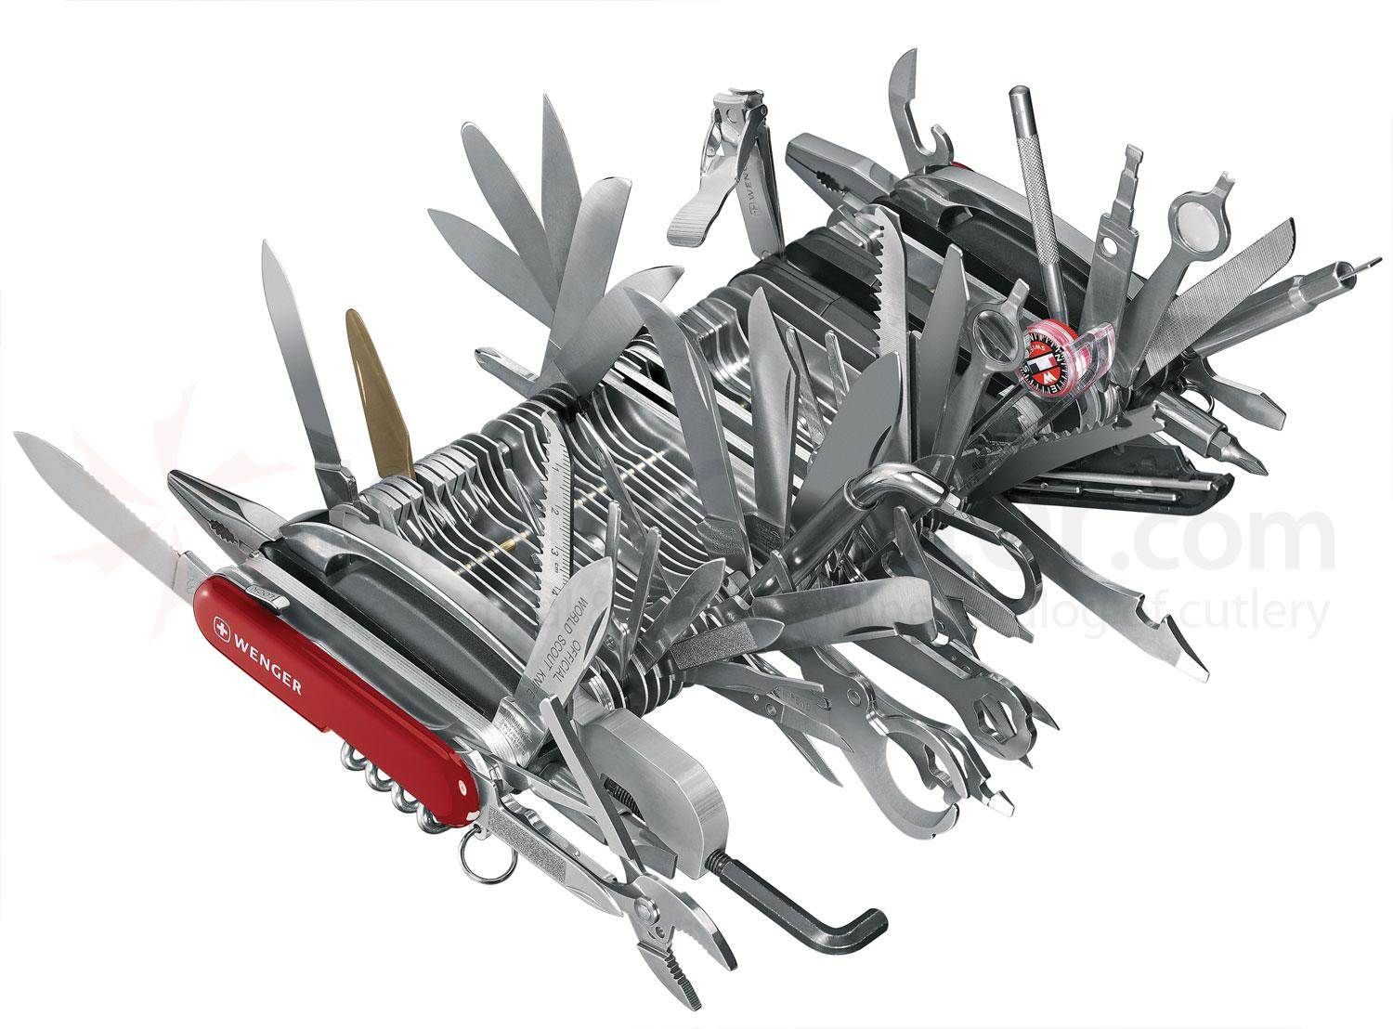

Slide 15
frameworks are… Outsourced General Purpose Abstractions
Notes:
- Deferring to another dev team to make key decisions about how your product should be structured

Slide 16
not not invented here
Notes:
It’s great to not reinvent the wheel
Be thoughtful about what tools you use – know the cost as well as the benefits
Try them out –that’s where we started

Slide 17
consider Size
Notes:
Initial download time
Will the file be cached

Slide 18
consider Performance
Notes:
Would purpose build code be faster?
Have we measured and are we confident?

Slide 19
consider Complexity
Notes:
What’s the learning curve?
How hard is it to swap out later on?

Slide 20
Mobile === Minimalism
Notes:
Not limited
Think: “Do I really need X.js”
Can I afford the download time on crappy connections

Slide 21
Mobile === Top Shelf User Experience
Notes:
Well if we had a native app….we could do X
Performance and interactions

Slide 22
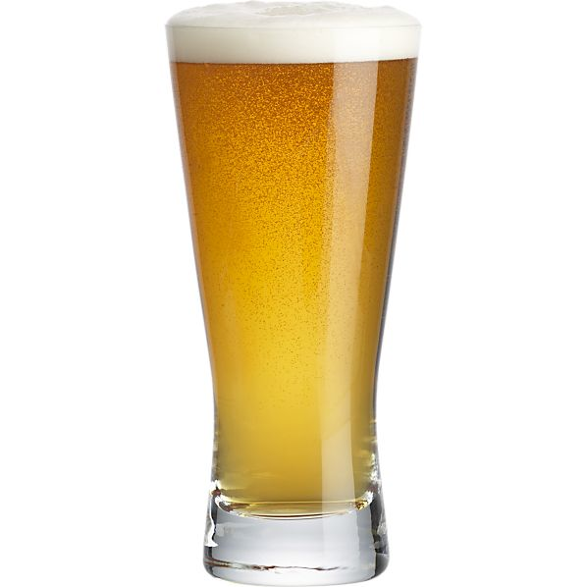

Slide 23
onTap
Notes:
Beer list
Breweries
Bars

Slide 24
JQuery (Utility Belt)
Backbone.js (Structure & Routing)
Handlebars.js (Building HTML)
KO.js (Managing DOM interactions)
JQuery Mobile (Mobile UI)
Notes:
Typical stack
What’s the cost?

Slide 25
what would it take to DIY?
Notes:
Web dev, specifically mobile web dev

Slide 26
start with the basics
Html, CSS, JavaScript
Notes:
Web dev, specifically mobile web dev

Slide 27
Architecture
Notes:
Do as much as we can on the client
Feels more responsive
Less data over the wire

Slide 28
Traditional Web App
Notes:
Do as much as we can on the client
Feels more responsive
Less data over the wire

Slide 29
Server
Client
Request
Notes:
RR

Slide 30
Server
Client
Request
Web UI
HTML/CSS/JS
Web UI
HTML/CSS/JS
Notes:
RR

Slide 31
Server
Client
Request
Web UI
HTML/CSS/JS
Web UI
HTML/CSS/JS
Web UI
HTML/CSS/JS
Web UI
HTML/CSS/JS
Notes:
RR

Slide 32
Server
Client
Request
Web UI
HTML/CSS/JS
Web UI
HTML/CSS/JS
Web UI
HTML/CSS/JS
Web UI
HTML/CSS/JS
Web UI
HTML/CSS/JS
Web UI
HTML/CSS/JS
Notes:
RR

Slide 33
Single Page App
Notes:
Do as much as we can on the client
Feels more responsive
Less data over the wire

Slide 34
Server
Client
Request
Notes:
RR

Slide 35
Server
Client
Request
Web UI
HTML/CSS/JS
Web UI
HTML/CSS
Application
JavaScript
Notes:
RR

Slide 36
Server
Client
Request
Web UI
HTML/CSS/JS
Web UI
HTML/CSS
Application
JavaScript
Navigation
Notes:
RR

Slide 37
Server
Client
Request
Web UI
HTML/CSS/JS
Web UI
HTML/CSS
HTML Rendering
Application
JavaScript
Navigation
Notes:
RR

Slide 38
Server
Client
Request
Web UI
HTML/CSS/JS
Web UI
HTML/CSS
HTML Rendering
Application
JavaScript
Navigation
Data Access
JavaScript
Notes:
RR

Slide 39
Server
Client
Request
Web UI
HTML/CSS/JS
Web UI
HTML/CSS
HTML Rendering
Application
JavaScript
Navigation
JSON Services
Data Access
JavaScript
Notes:
RR

Slide 40
REQUIREMENT: Welcome view and an About view

Slide 41
getting around without URLs

Slide 42
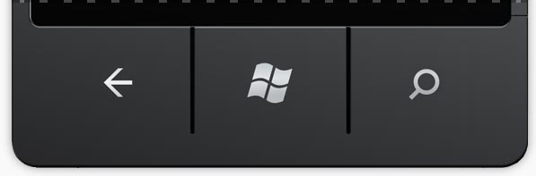
getting around without URLs

Slide 43
window.location.hash
Notes:
- Use browser history for our own purposes
DEMO
Show how to set window.location.hash
Back and forward navigation
How the url changes but the page doesn’t navigate

Slide 44
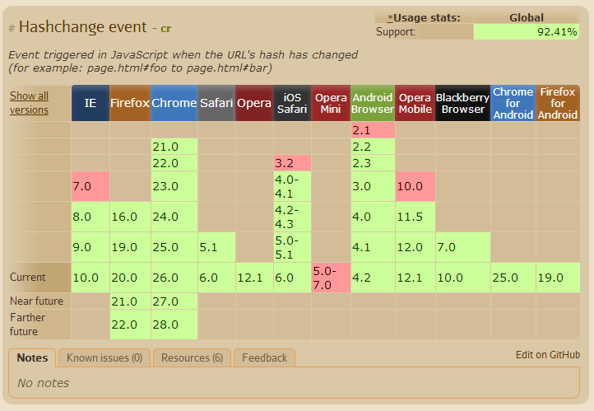

Slide 45
<script id="HomeView" type="text/html">
<h1>On Tap</h1>
<p>
<a href="#AboutView">Learn More</a>
</p>
</script>
<script id="AboutView" type="text/html">
<h1>
<div class="backArrow" onclick="window.history.back();">&larr;</div>
About
</h1>
<p>…</p>
</script>
<script type="text/javascript">
…
$(window).on('hashchange', function(){
// parse the hash
// get appropriate content
// update the view
});
…
</script>

Slide 46
REQUIREMENT: List of beers, list of breweries, and list of bars.

Slide 47
<script id="HomeView" type="text/html">
<ul>
<li data-nav="BeersView">Beers</li>…
</ul>
</script>
<script id="BeersView" type="text/html">
<h1><div class="backArrow">&larr;</div>Beers</h1>…
</script>
<script id="BreweriesView" type="text/html”>…</script>
<script id="BarsView" type="text/html”>…</script>
<script type="text/javascript">
…
$(window).on('hashchange', function(){
…
view.on('click', '[data-nav]', function(){
window.location.hash = $(this).data('nav');
})
$('.backArrow').on('click', function(){
window.history.back();
});
})
…

Slide 48
REQUIREMENT: Bars can be expanded to show contact info.

Slide 49
var foo = {}; foo.cow = ‘moo’; foo[‘cow’] === foo.cow

Slide 50
<script type="text/javascript">
$(function() {
var viewContainer = $('#view-container'),
views = {};
views.BarsView = function(){
…
return view;
};
$(window).on('hashchange', function(){
if (views[hash] !== undefined) {
view = views[hash]();
} else {
view = $('<div/>').append($('#' + hash).html());
}
viewContainer.html(view);
…
}
</script>

Slide 51
REFACTOR

Slide 52
IIFE

Slide 53
IIFE
Immediately Invoked Function Expression
Notes:
Pollute global namespace.
Keep out code contained.

Slide 54
var foo = (function(){}());
Notes:
JS is function scoped, not block scoped.
Prevents us from polluting the global namespace with functions and variables.

Slide 55
Revealing Module Pattern

Slide 56
var sillyAdder = (function(){ var x = 123; function add(a, b) { return helper(a, b); } function helper(a, b) { return a + b + x; } return { Add: add }; }());
Notes:
JS is function scoped, not block scoped.
Prevents us from polluting the global namespace with functions and variables.

Slide 57
sillyAdder.Add(1, 2);
Notes:
JS is function scoped, not block scoped.
Prevents us from polluting the global namespace with functions and variables.

Slide 58
<script type="text/javascript">
var mobile = (function() {
function renderView(viewName){ … }
function addView(name, renderFcn){…};
function navigate(name){…}
return {
View: addView,
Navigate: navigate
};
}());
</script>
<script type="text/javascript”>
mobile.View('BarsView', function(){…});
$(function() {
mobile.Navigate('HomeView');
});
</script>

Slide 59
REQUIREMENT: Beer list should show the user’s favorite beers.

Slide 60
<script id="BeersView" type="text/html">
<h1><div class="backArrow">&larr;</div>Beers</h1>
<p>{{count}} beers logged</p>
<ul>
{{#each beers}}
<li>{{Name}} <weak>{{Rating}} out of 5</weak></li>
{{/each}}
</ul>
</script>
<script type="text/javascript" src="handelbars.js"></script>
mobile.View('BeersView', function(){
var view = $('<div/>'),
template = Handlebars.compile($('#BeersView').html());
$.getJSON('beers.json', function(beers){
var viewModel = {
count: beers.length,
beers: beers
};
var beerList = template(viewModel);
view.html(beerList);
}); …

Slide 61
REQUIREMENT: Show beer detail when a beer is selected.

Slide 62
function navigate(name, state){
if (!started){
window.location.hash="";
// start responding to hash change
$(window).on('hashchange', function(){
var hash = window.location.hash.split('#')[1];
hash = JSON.parse(decodeURIComponent(hash));
renderView(hash.name, hash.state);
});
started = true;
}
var route = {
name: name,
state: state
};
route = encodeURIComponent(JSON.stringify(route));
window.location.hash = route;
};

Slide 63
REQUIREMENT: Show a list of all the breweries from the beers list.

Slide 64
mobile.View('BeersView', function(){
$.getJSON('beers.json', function(beers){
…
});
});
mobile.View('BeerDetailsView', function(state){
$.getJSON('beers.json', function(beers){
// find the beer with the matching ID
});
});
mobile.View('BreweriesView', function(state){
$.getJSON('beers.json', function(beers){
// pull out all the breweries
});
});

Slide 65
Smart about data

Slide 66
var getBeers = $.getJSON('beers.json'),
getBreweries = getBeers.then(function(beers) {
var breweries = [];
// pull out all the breweries
for (var i = 0; i < beers.length; i++) {
if (breweries.indexOf(beers[i].Brewer) === -1) {
breweries.push(beers[i].Brewer);
}
}
return breweries;
});
mobile.View('BeersView', function(){
getBeers.done(function(beers){…});
});
mobile.View('BeerDetailsView', function(state){
getBeers.done(function(beers){…});
mobile.View('BreweriesView', function(state){
getBreweries.done(function(breweries) {…});
});

Slide 67
Transitions

Slide 68
<style type="text/css">
#view-container > div {
position: absolute;
top: 0;
left: 0;
width: 100%;
margin-top: 0;
transition: all 0.2s ease-in-out;
-webkit-transition: all 0.2s ease-in-out;
}
.off-right {
transform: translateX(100%);
-webkit-transform: translateX(100%);
}
.off-left {
transform: translateX(-100%);
-webkit-transform: translateX(-100%);
}
</style>

Slide 69
function showFromLeft(view){
var viewContainer = $('#view-container');
var currentView = viewContainer.find('div');
// set the new view off right
view.addClass('off-right');
viewContainer.append(view);
window.getComputedStyle(view[0])['-webkit-transform'];
window.getComputedStyle(view[0])['transform'];
// slide both views to the left
currentView.addClass('off-left');
view.removeClass('off-right');
// remove the old view
currentView.on('transitionend', function(){
currentView.remove();
});
}

Slide 70
Faster Clicks

Slide 71
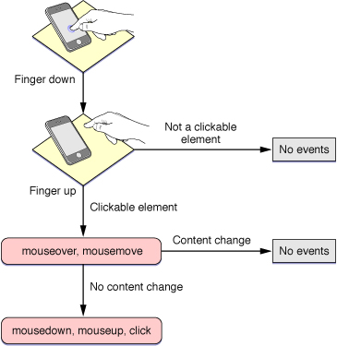
Source: http://developer.apple.com/library/ios/#documentation/AppleApplications/Reference/SafariWebContent/HandlingEvents/HandlingEvents.html#//apple_ref/doc/uid/TP40006511-SW6

Slide 72
touchstart 000ms touchend 111ms mousemove 466ms mousedown 469ms mouseup 471ms click 472ms
Event Simulation

Slide 73
fastClick.js

Slide 74
Diet
jQuery.js(80kb)
zepto.js (10kb)

Slide 75
Diet
jQuery.js(80kb)
zepto.js (10kb)
vanilla.js (free)

Slide 76
[Wrap Up]
Notes:
Frameworks don’t’ do magic
We know the shape and requirement of our products better than anyone else
We can get a lot done with little effort using the built in tools and features
Shared some techniques and given you an alternative perspective.

Slide 77
Thanks!
Notes:
Thanks for listening and enjoy lunch!

